Slide 1
Optimal Location for A Restaurant
Jason Dunlop

Slide 2
Scenario - Analyzing a large city to identifying the best neighborhood to open a restaurant by:
Data Preparation: Using open source data available online (Wikipedia) to pull city (London) population by ethnicity.
Data Understanding: Using Foursquare data to identify the latitude and longitude coordinates of the neighborhoods that house the most popular restaurant doors
Data Understanding: Clustering the neighborhoods by similarities in their venues
Deployment: Analyze the results and make a conclusion based on the analysis.

Slide 3
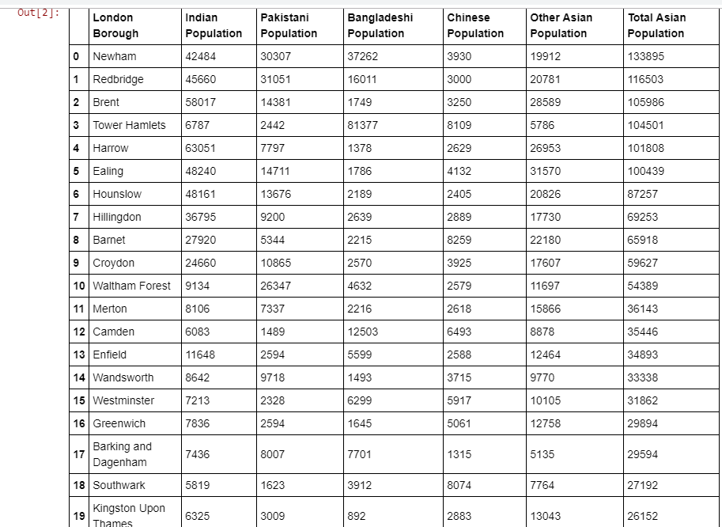
Data used to discover the population by Ethnicity to see if a specific Indian Cuisine could house the demand!
Data Preparation

Slide 4
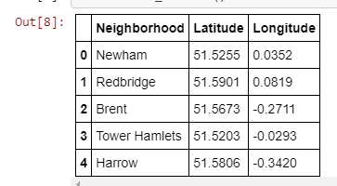
Data Preparation
Location data was appended to scrape the data in order access the Foursquare API
The 2nd dataframe then organized by neighborhood to understand the relationships to each other in a large city
Location coordinates added to the dataframe to help prepare for Mapping

Slide 5
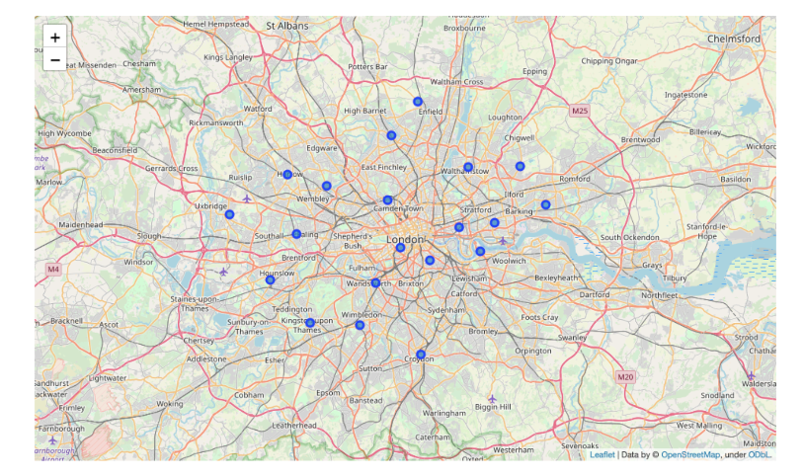
Data Understanding
Using the location coordinates to show all the available neighborhoods available to open restaurant location

Slide 6
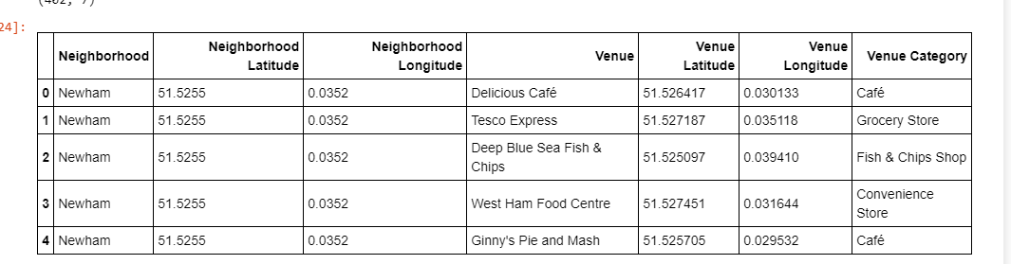
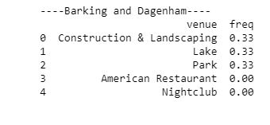
Venue coordinates pulled within each neighborhood to show the ethnicity of the cuisine and their distance in relation to each other. Example below:
Data Understanding
Venues frequency of occurrence by neighborhood to show the most popular cuisines. Example

Slide 7
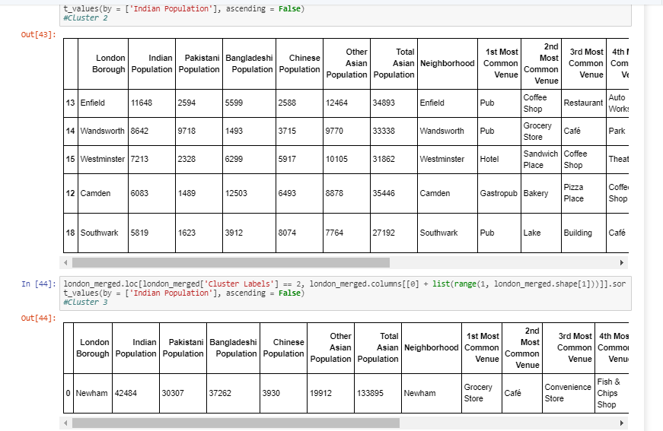
Data Understanding
Clusters were generated using K means

Slide 8
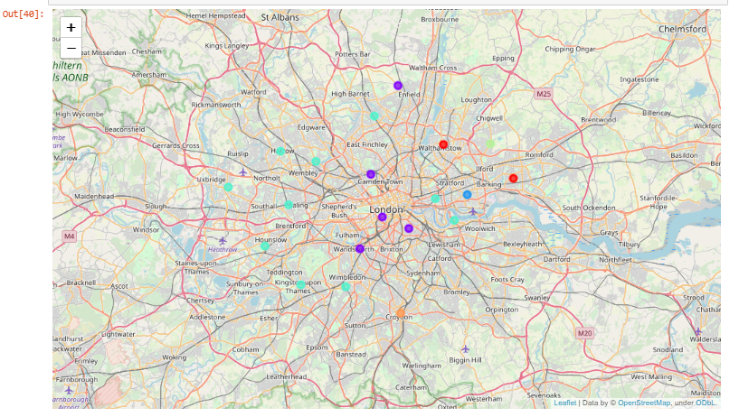
Data Understanding
Plotting clusters on a mapping for Data Visualization

Slide 9
Conclusion
As far as we can see with this data, the highest amount of Indian population is located at Harrow represented in cluster 1. If a deeper exam is performed into this cluster, it is noticeable that the living population in here ranks it the 5th most Asian inhabited borough. Apart of this fact, a strange closeness to Indian food can be found as the 8th most prominent venue in here is Middle Eastern restaurant which, while not being an Indian restaurant is the closest match to an Indian cuisine restaurant. By following this logic, if we would like to open a new Indian restaurant in the city or any kind of restaurant in fact, it would only be necessary to find a where are the restaurants similar the one we want to open, study the population in that area, and find similar clusters of population in the city that don't have yet or have very few restaurants like the one we would like to open. In this example, clusters 1 could make a good match for our target population. Looking at the venues in this cluster, it is possible to find two Indian restaurants, and a good bunch of Middle Eastern restaurants and coffee shops. So, in this cluster, it is possible to state that the existing restaurants matches the population's nationalities and tastes.
In conclusion and taking into consideration the explanations given above as well as the data, it is highly possible that cluster 1 could be a good place to open our Indian restaurants. As explained above, the same logic could apply to open other kind of restaurants or business in any other area of the city. It is only necessary to examine the existing businesses in our target area, and study the population, then compare these 2 factors with the same ones in areas where there are existing business like the one we want to open, and then verify if the matching is correct.

